Slide 1
2-3 TREE
By: Abdelrahman Zanatii

Slide 2
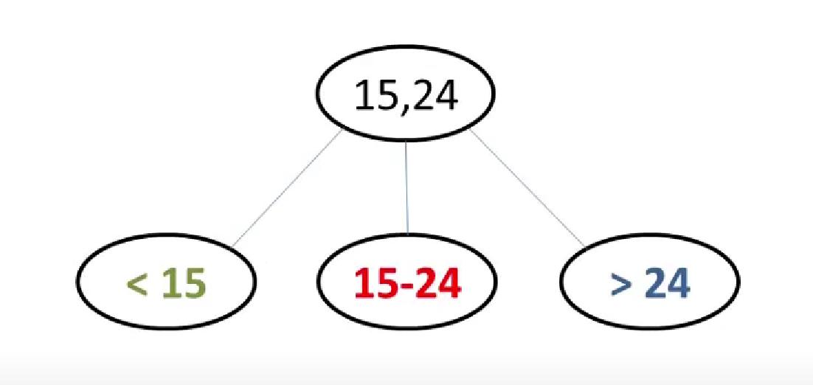
PROBLEM
A type of multi way data structure.
All leaf nodes must be at same level.
The Tree is always sorted.
It contains two types of nodes:
2 Node, with 1 value and 2-children.
3 Node, with 2 values and 3-children.

Slide 3
CONSTRUCTION
ALGORITHM
If the tree is empty, create a node and insert the value.
Otherwise find the leaf node where the value belongs.
If the leaf node has only one value, put the new value into the node
If the leaf node has more than two values, split the node and the median node becomes the parent.
Time Complexity of Insertion, Deletion, and Search is O(log N).

Slide 4
INSERTION
Insert: 13 7 24 15 4 29 20 16
13
7, 13
7, 13, 24
13
13
7
24
4,7
15,24
13
13,24
4,7
15,24,29
4,7
29
15

Slide 5
INSERTION
Insert: 13 7 24 15 4 29 20 16
16
13,24
13,16,24
13
24
29
4,7
29
4,7
15
20
15,16,20
16
4,7
15
20
29
15
20

